Slide 1
CHANGING POLARIZED BELIEFS USING SOCIAL CONSENSUS AND MORAL CONVICTION
Sean Duan

Slide 2
Defense Overview
Introduction
Why this topic?
Project Timeline
Studies
1: Social Consensus
2: Moral Conviction
3: Social Consensus x Moral Conviction
Research Findings
Future Directions?
Questions?

Slide 3
Why this topic?
Notes:
Why are we looking at polarized beliefs for my dissertation?

Slide 4
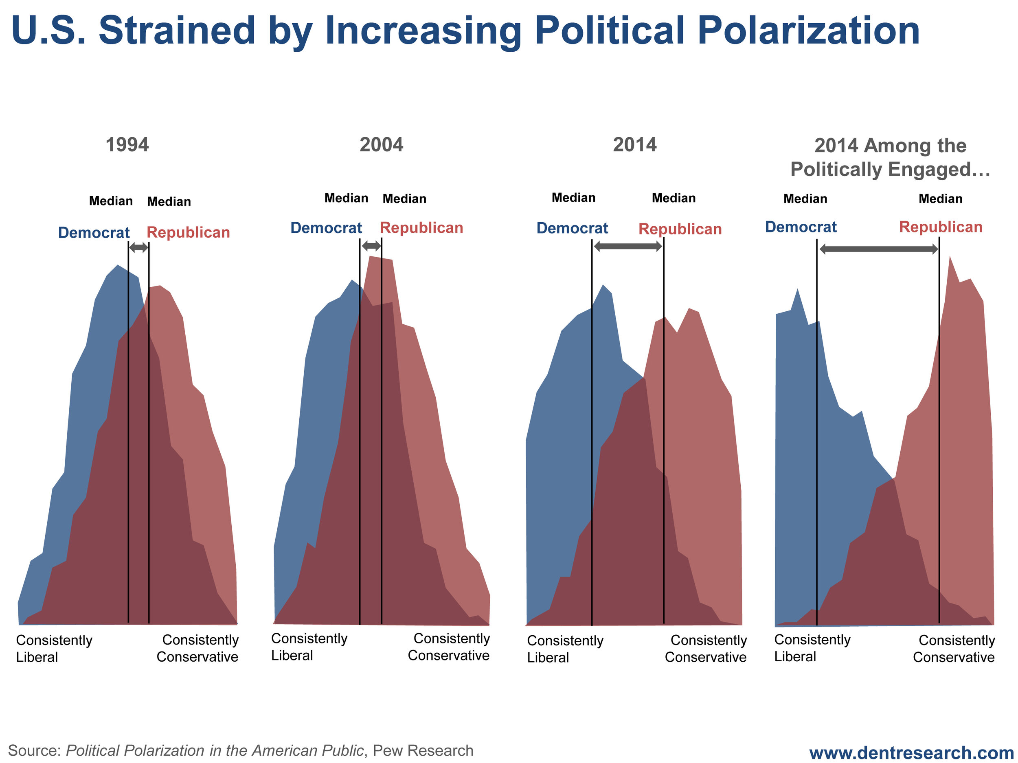
Polarization is Increasing
Notes:
In the literature of attitude change and formation, polarized beliefs (i.e. beliefs that are at one extreme or another) are known to be difficult to change
This problem has been increasing, as polarized beliefs rooted in misinformation have contributed significantly to public health crises such as reduction in vaccination due to polarization of vaccination beliefs
The purpose of this dissertation was to empirically test how several different theories from the broader literature of attitude change applies to polarized beliefs specifically, and if we can successfully increase or decrease support for these polarized beliefs.
The two mechanisms we used to do this were Social Consensus and Moral Conviction – which I will define shortly

Slide 5
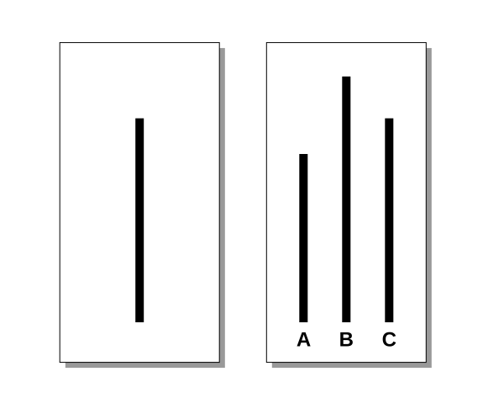
What is Social Consensus?
Notes:
We can define it as an agreement among members of a society about what is acceptable behavior or belief.
Lets use the classic Asch line experiments from the 50s as an example
People were asked which line on the right matches the one on the left (it’s C), but the twist was, before they answered, actors working for the study would give incorrect answers (either longer or shorter)
This is a very easy task, but the pressure to conform to consensus was so great that over 70% of participants were induced to conform to an incorrect answer.
People can be members of many societies, but the societies that are closer and more integral to one’s identity are those that are most impactful at changing belief (the ‘society’ for the asch experiments were just the people in the room)

Slide 6


Why are we using Social Consensus?
Notes:
there is a long history of evidence that shows its effectiveness
prior literature has shown that social consensus is associated with attitude formation and change for many topics that are currently considered highly polarized, such as climate change, weight discrimination, and racial stereotyping, thus, I believe it is likely to see some effect of empirically testing social consensus on polarized beliefs as a category.
Additionally, it is a relatively low cost and conceptually simple intervention – providing information about consensuses that exist does not require immense resources. Manipulation of social consensus as a way to change polarized belief was the goal of our study 1.
This brings us to the next important element of this dissertation – the concept of moral conviction

Slide 7
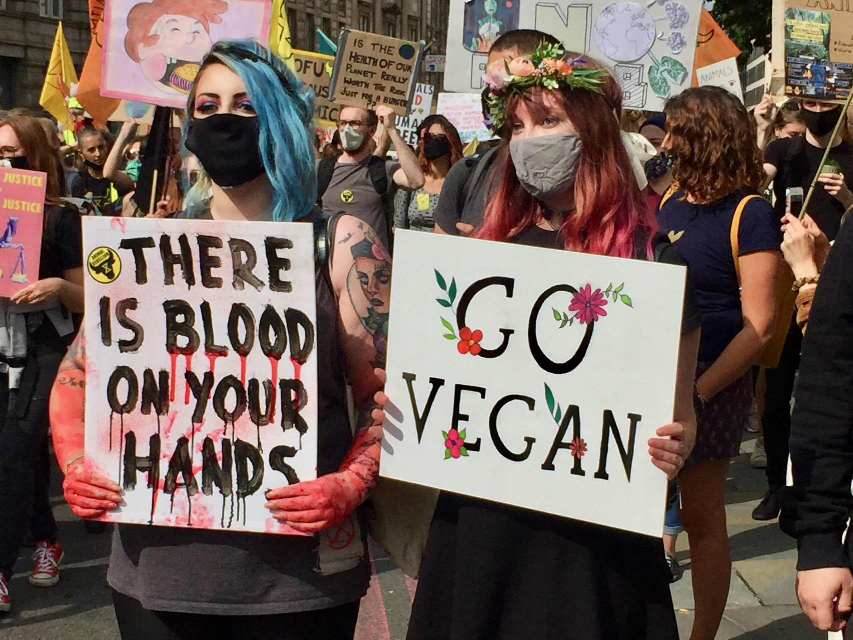
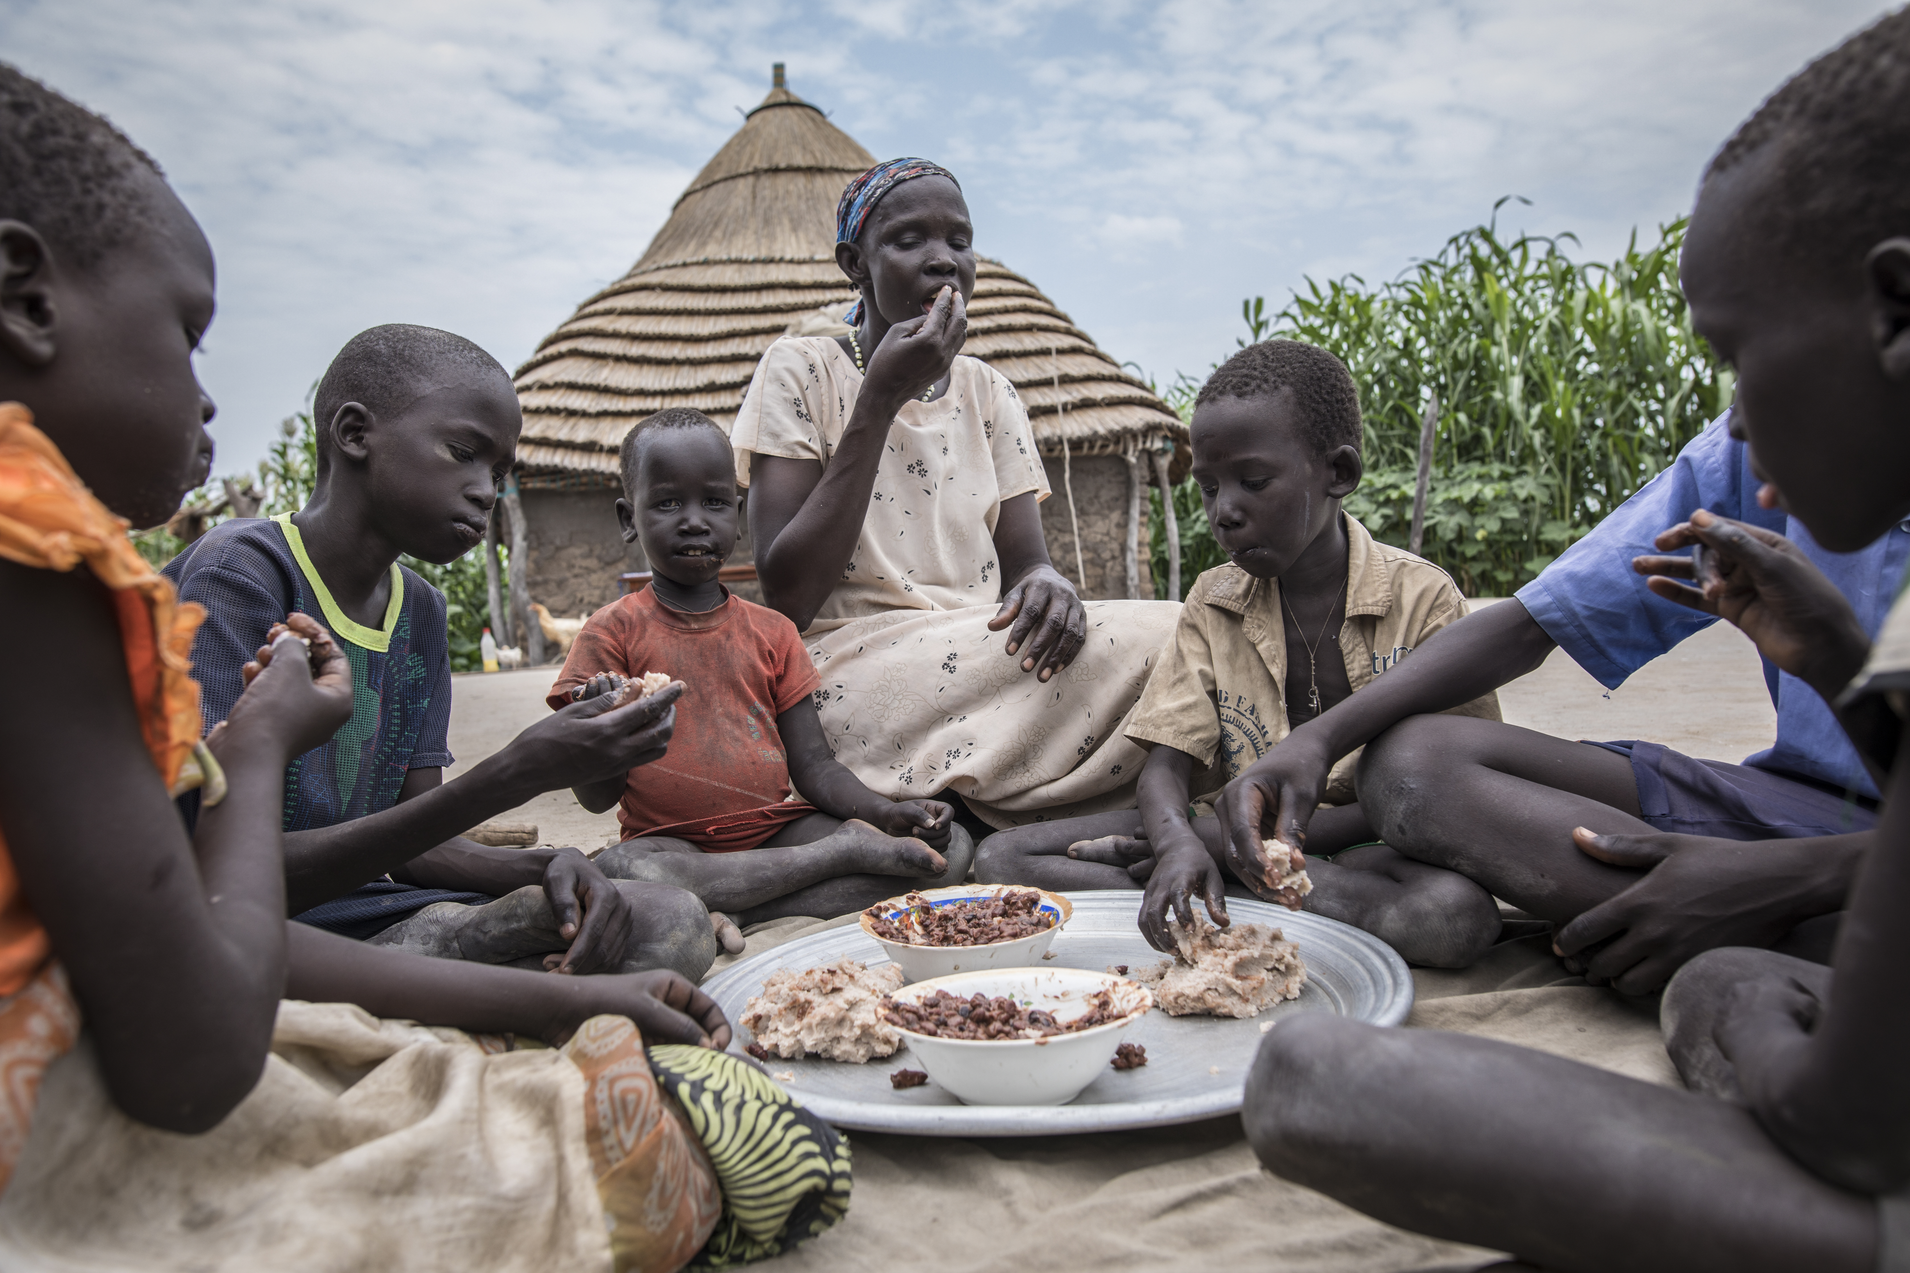
What is Moral Conviction?
Notes:
Lets define Moral conviction and then provide an example, essentially, it is “the perception that one’s feelings about a given attitude object are based on one’s beliefs about right and wrong”
The people in this first picture are vegan – they’re vegan because of ethical reasons
The people in this second picture are also vegan – they’re vegan because of economic reasons
Both groups of people have support for veganism, but the level of ‘moral conviction’ in these beliefs can differ wildly
For the people in the first picture, they see their attitude towards veganism being based on objective beliefs about what is ethically right or wrong to do. Unsurprisingly, beliefs held with sincere moral conviction are very hard to change.
For the people in the second picture, their attitude towards veganism is entirely based on the pragmatic fact that beans, rice, and other plant-based foods are significantly cheaper and easier to get access to, if the situation they found themselves in were different, it would be relatively easy to have them change this belief.
If we view the space between picture 1 and 2 as a continuum, it naturally follows that if we can reduce moral conviction, we can increase openness to change

Slide 8
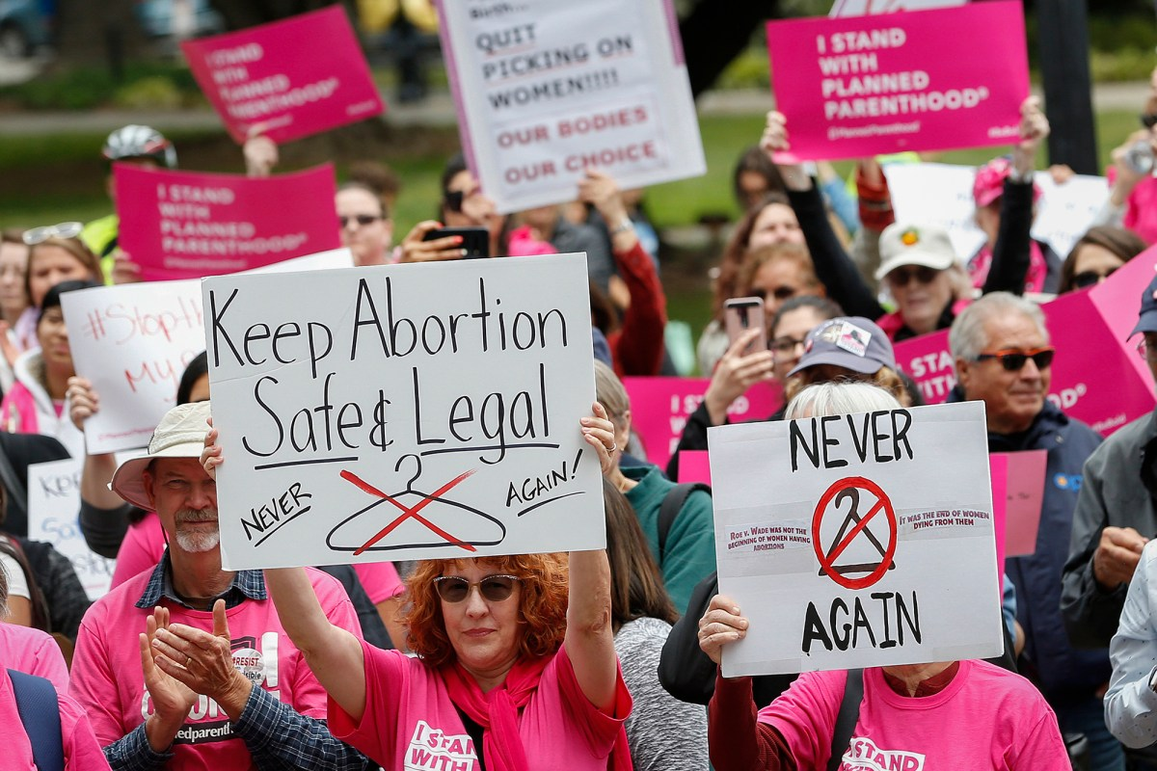
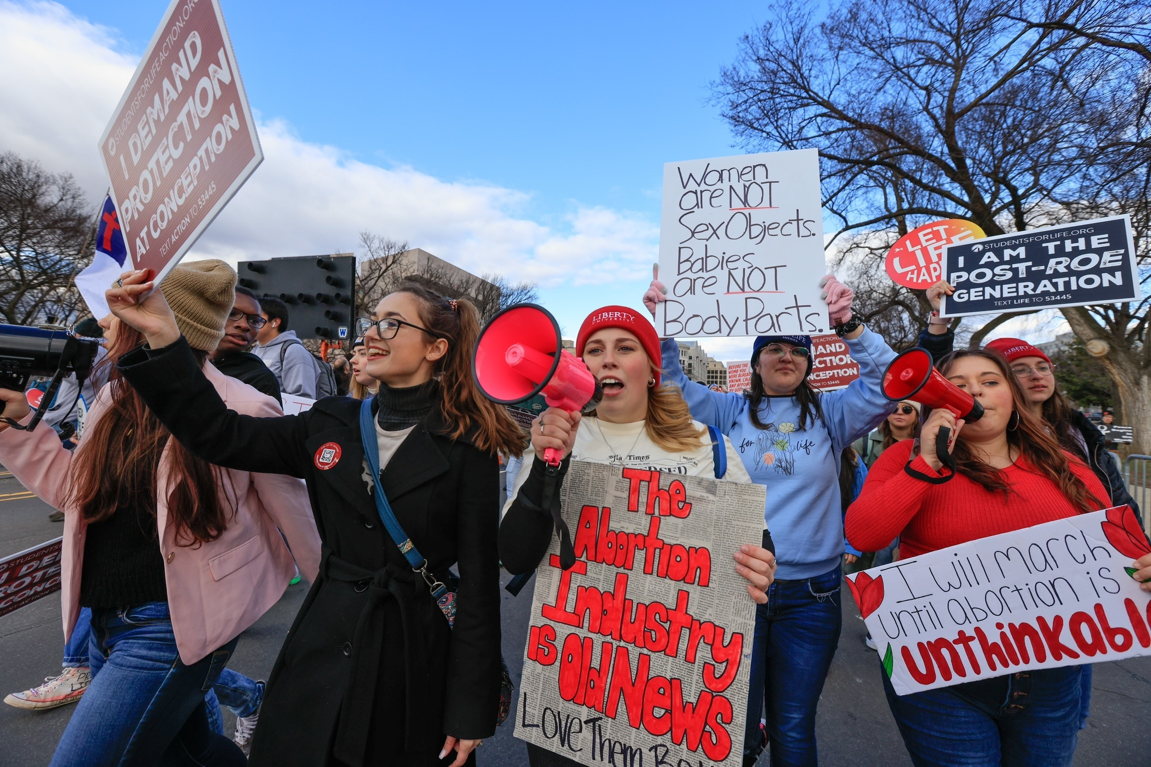
Why are we using Moral Conviction?
Notes:
Moral conviction is extremely relevant to the dissertation specifically, because in practice, many polarizing beliefs, both for and against, are felt with ‘moral conviction’
Abortion access is a perfect example – some individuals who protest in favor of abortion access view their position has having moral conviction, because from their perspective allowing for an individual to have greater control over health care choices regarding their own body is about what is fundamentally right or wrong.
Likewise, some individuals who protest against abortion access view their position as having moral conviction, because from their perspective abortion is the murder of a child, and they view child murder as unacceptable, from the perspective of what is fundamentally right or wrong. Beliefs that are viewed with high levels of moral conviction are seen as ‘objectively true’ and ‘universally applicable in all cases’ – conversely, beliefs with low levels of moral conviction are viewed as subjective preferences where legitimate disagreement is acceptable. This perception of subjectivity leads to greater tolerance for differences and willingness to change opinion, which is the goal of the study.
Manipulation of moral conviction as a way to affect polarized belief was the goal for study 2
Furthermore, moral conviction and social consensus are worth studying jointly, as prior literature indicates that they should interact -

Slide 9
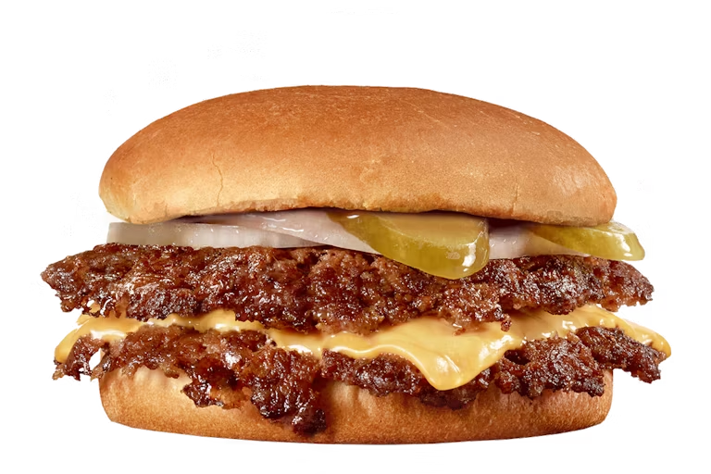
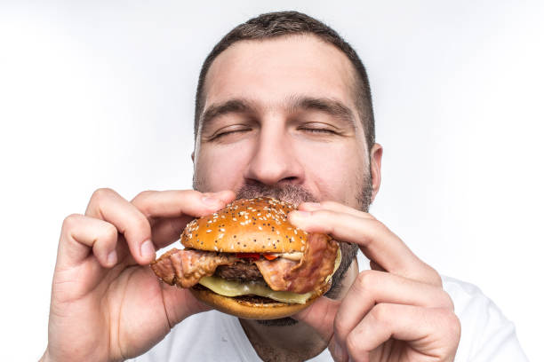
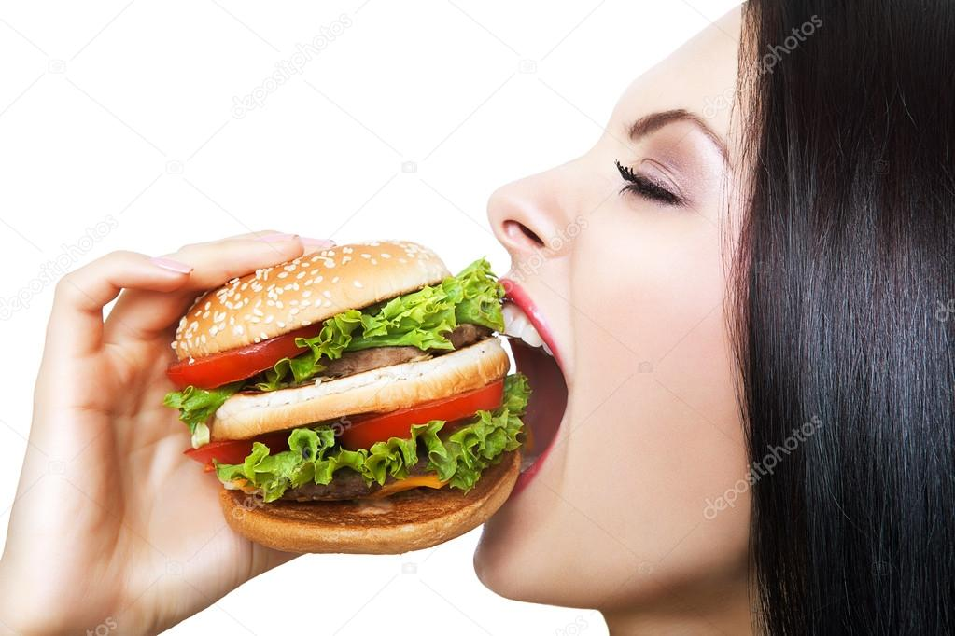
How do Social Consensus and Moral Conviction Theoretically Interact?
Notes:
High levels of moral conviction ‘inoculate’ individuals from being influenced by social consensus.
Lets go back to an earlier example
The vegan for ethical reasons is going out with their friends to a restaurant, they ended up picking a burger joint
Because they feel that eating meat is ethically wrong, even though they might be feeling some peer pressure, they are resistant to the social consensus, and
Do NOT eat a burger!
In contrast, the vegan for economic reasons is going out with the same friends, to the same restaurant, for them, a burger is simply a splurge, something that isn’t the most thrifty, but certainly not something that they have a fundamental ethical opposition to – in this example, the peer pressure works and they end up splurging and buying a burger with their friends.
This theorized relationship has not been empirically tested with direct manipulation of social consensus and moral conviction, which was the goal for our Study 3.

Slide 10
Project Timeline
Effect of Social Consensus on polarized belief
Effect of Moral Conviction on polarized belief
Interaction between social consensus and moral conviction
Study 1
Study 2
Study 3
SP 2022
SP/SS 2023
FA 2024
Notes:
All of that context gets us up to speed with the project timeline and what the goals of our 3 studies were

Slide 11
Study 1
Effect of Social Consensus on Polarized Belief
Notes:
Can we leverage social consensus to manipulate levels of support for polarized beliefs?

Slide 12
Research Question
Can we influence polarized belief with social consensus?
Can we increase support for polarized belief using high social consensus?
Can we decrease support for polarized belief using low social consensus?
Notes:
Can we influence polarized belief with social consensus?
Can we increase support for polarized belief using high social consensus?
Can we decrease support for polarized belief using low social consensus?

Slide 13
Study Design
Repeated measures design
Independent Variable:
Social Consensus: Low (-20%) or High (+20%)
Time: Before or After consensus manipulation
Four topics
Capital Punishment
Universal Health Care
Climate Change
Slavery
Notes:
This was a repeated measures design; I measured support for the polarized topics both before and after the consensus manipulation
Participants were randomized into either a low social consensus condition, or a high social consensus condition
Our participants were 505 psych 1000 students – around 19 years old, mostly female, and mostly white

Slide 14
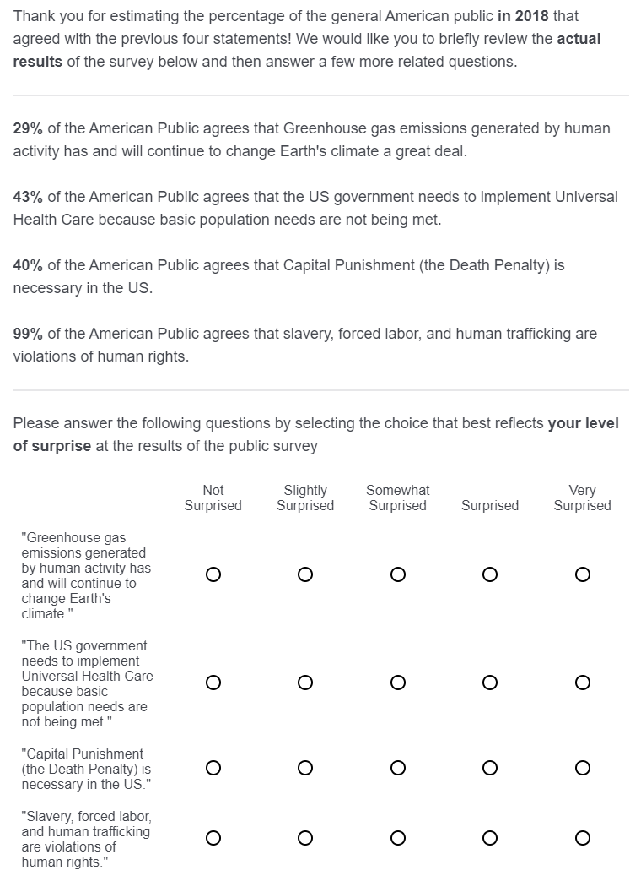
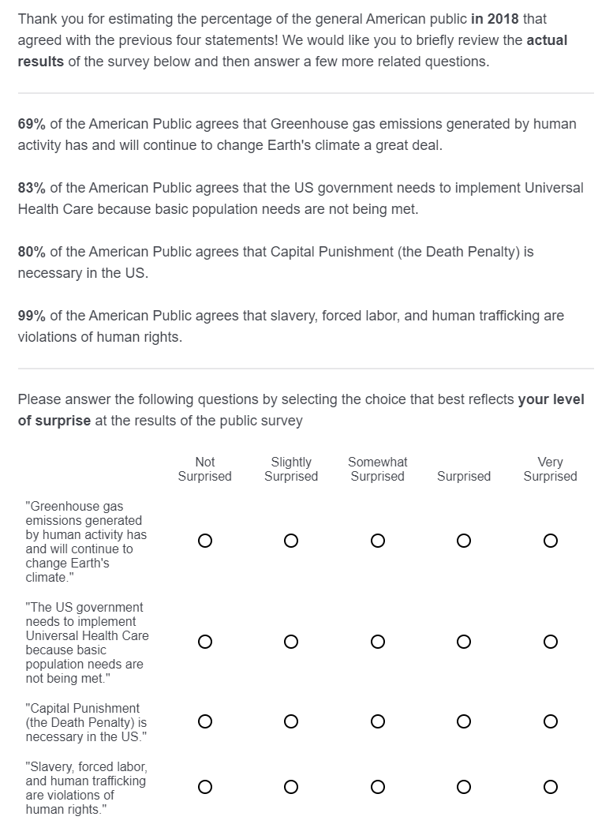
Method
Low social consensus condition
High social consensus condition
Notes:
Our social consensus intervention consisted of participants being given information about what proportion of Americans supported each of the polarized topics.
The four topics we chose were Climate change, capital punishment, universal health care, the topic of slavery, which was present to provide the additional
context of an overwhelming consensus (e.g., slavery is bad)
Ostensibly the results of the survey, we directly manipulated social consensus by increasing or decreasing the proportion of support artificially.
In the low social consensus condition, participants were given values that were 20% lower than current U.S. survey data indicated
in the high social consensus condition, participants were given values that were 20% higher

Slide 15
Outcomes
Notes:
The outcomes, which were measured both before and after the social consensus intervention, was degree of support for the polarized topics that we assessed.
We measured this by degree of agreement with statements in support of the polarized topics
Support for each topic ranged from 0 (strong disagreement of support) to 100 (strong agreement of support)

Slide 16
Hypothesis
H1: Significant condition x time interaction
H1a: No difference between conditions at baseline
H1b: Increase in support for high social consensus at time 2
H1c: Decrease in support for low social consensus at time 2
Notes:
Our initial hypothesis was very direct – does manipulation of social consensus affect support for a topic?
Specifically, can we increase support in high social consensus conditions, and can we decrease support in low social consensus conditions?

Slide 17
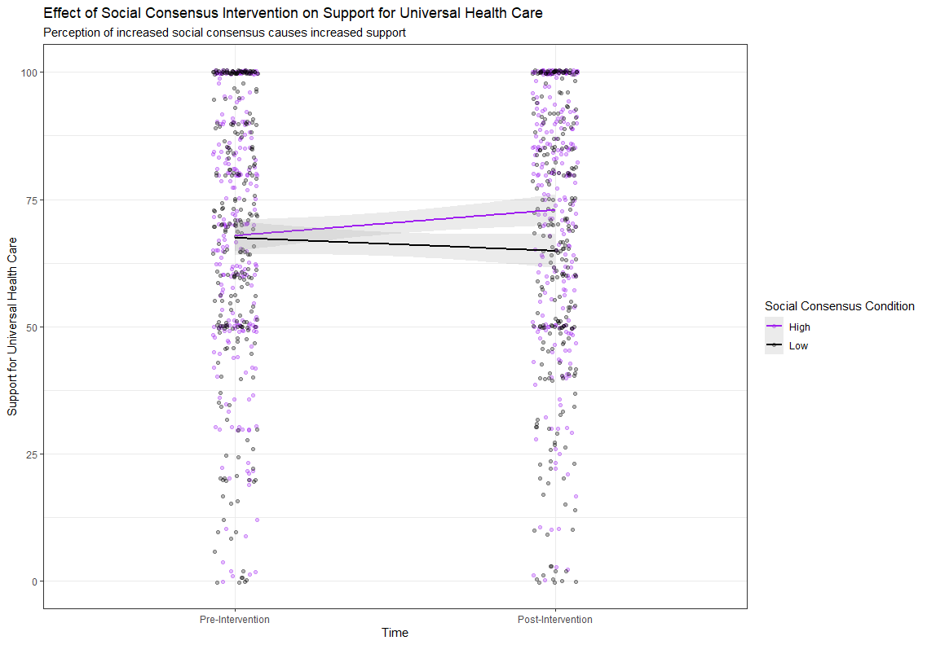
Results
Notes:
First, I would like to orient you all to what the graph says
The Y- axis here shows support for the topic, in this case, universal health care
The X-axis shows time, either before or after our intervention
The color coding shows which intervention individuals received, purple for the high social consensus, and black for the low social consensus intervention
The lines that go through the clouds of dots essentially summarize the relationship between condition and time.
Both groups had similar levels of support at baseline – there was also a significant interaction between condition and time, we can see this from how the purple and black lines diverge at time 2. This pattern of significant differences at time 2 between high and low consensus was repeated across all topics
We saw a significant increase for support in our high social consensus condition, indicated by how ‘steep’ the purple slope was, for UHC only, and not any other topics.
We did not see a significant decrease in support in our low social consensus condition, indicated by how steep the black slope was, for any of our topics.

Slide 18
Conclusions
Significant interaction between condition x time
Social consensus intervention can increase support for UHC
Less successful at decreasing support
Social consensus intervention based on deception has practical implementation issues
Notes:
I saw some preliminary evidence that, for some topics, the effect of social consensus is able to change support, primarily through increasing it (did not see significant evidence of decrease)
Something I glossed over however, was how many additional hoops I had to jump through regarding ethics around deception – Even the original ‘asch’ line study explicitly relies on confederates who are willing to lie
In many cases it is not ethically feasible to deceive the public as to what other people around them believe

Slide 19
Study 2
Effect of Moral Conviction on Polarized Belief
Notes:
Study 2 was then launched to look at alternative means for changing polarized beliefs

Slide 20
Research Questions
Can we increase moral conviction using moral framings?
Moral responsibility framing
Moral piggybacking framing
Can we decrease moral conviction using nonmoral framings?
Pragmatic framing
Hedonic framing
Notes:
The first research question was, can we increase moral convictions using moral framings?
I tried two methods, the first – moral responsibility, increases perception of morality by framing the subject using rights, promises, or obligations, that one group or others are expected to uphold the second – moral piggybacking, increases perception of morality for the subject by tying it to concepts that are already agreed upon as moral
The next research question was conversely, can we decrease moral conviction using nonmoral framings?
Likewise, I tried two methods, the first – pragmatic, decrease perceptions of morality by emphasizing economic and practical implementation concerns, the second hedonic framing, decrease perception of moral conviction by emphasizing the direct personal benefits that supporting the topic will result in.

Slide 21
Study Design
Independent Variable – Moral Conviction:
Moral Responsibility
Moral Piggybacking
Pragmatic
Hedonic
Control
Four topics
Universal Health Care
Capital Punishment
Climate Change
Exercise
Notes:
Describing our study design, we had 208 psych 1000 students as participants, and no further demographic information was collected as we were concerned about survey length and had no a-priori demographic hypotheses
Participants in our four experimental conditions, highlighted here in green and red, were given four essays – all sharing the same moral framing on four topics chosen, UHC, capital punishment, climate change, and exercise
Participants in the control condition received no experimental materials
Afterwards, all participants were surveyed on their level of moral conviction felt for the issue
Next I will briefly show you some excerpts from these essays on the topic of universal health care

Slide 22
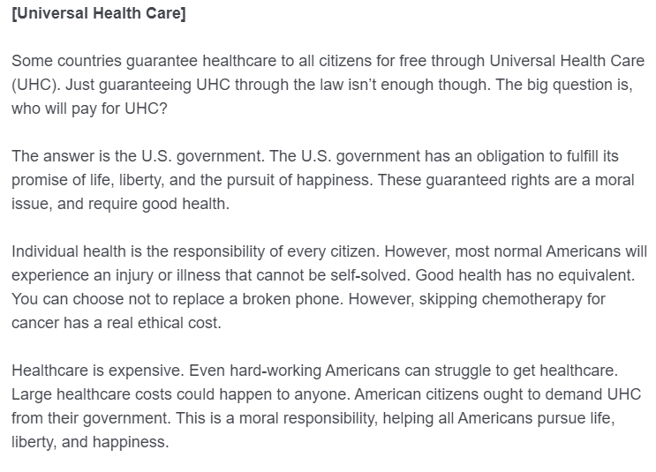
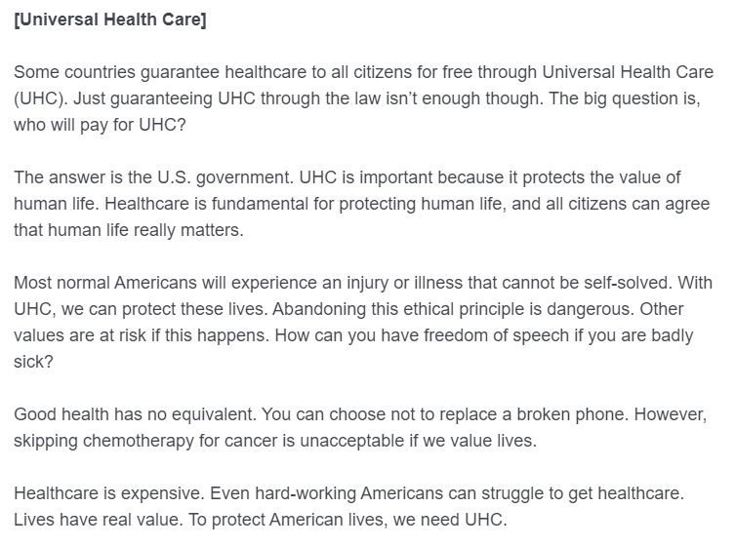







Method
Moral Responsibility condition
Moral Piggybacking condition
Notes:
You can see here in the first excerpt, we implemented the moral responsibility framing by emphasizing the obligations the US government entails upon it’s claims of guaranteeing ‘life, liberty and the pursuit of happiness’
In the second excerpt, we use moral piggybacking to tie offering healthcare to the extant moral value of human life, and the inability to exercise the morally relevant ‘right to free speech’ if unhealthy.

Slide 23
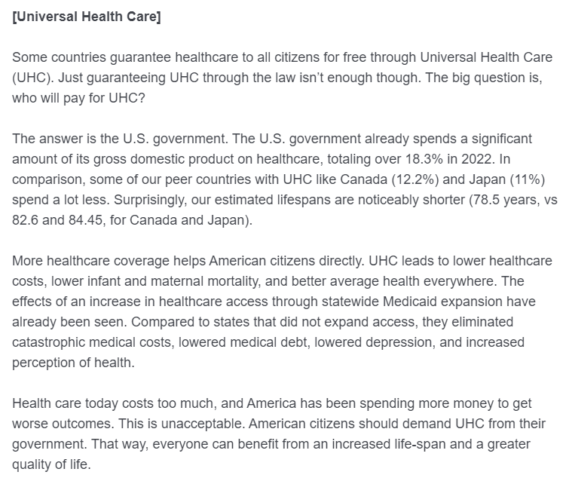
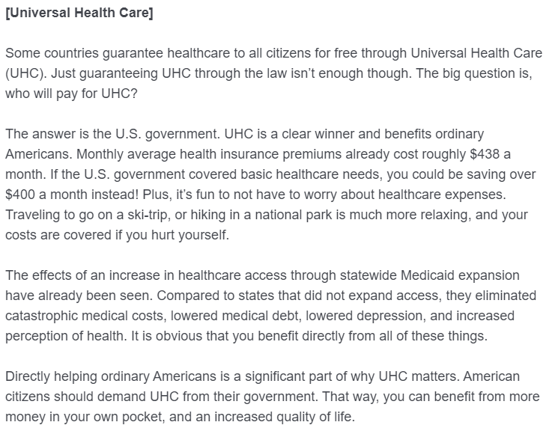






Method
Pragmatic condition
Hedonic condition
Notes:
In this next excerpt, we show the pragmatic framing, we emphasize some of the practical benefits of implementing UHC, such as longer lifespan and better average health
In the last excerpt, we show the hedonic framing, where we focus on how saving on healthcare expenses benefits you directly, and how fun and stress free it is to not be concerned about healthcare

Slide 24
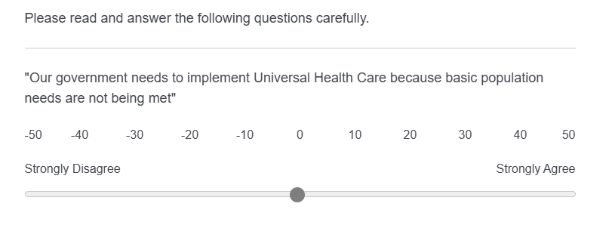
Outcomes
Notes:
Our outcome measures were jointly, the support for topic measure used in Study 1, and the 7 item aggregate moral conviction measure used in Study 2.

Slide 25
Hypothesis
H1: Moral Piggybacking and Moral Responsibility groups will have increased moral conviction compared to control
H2: Pragmatic and Hedonic groups will have decreased moral conviction compared to control
Notes:
Our initial hypothesis was very direct – can differently moral framings affect moral conviction for a topic?
Specifically, can we increase moral conviction with our moralized framings, and decrease moral conviction with our nonmoral framings?

Slide 26
Hypothesis
H3: Differences in moral conviction will result in differences in support
Notes:
Our initial hypothesis was very direct – can differently moral framings affect moral conviction for a topic?
Specifically, can we increase moral conviction with our moralized framings, and decrease moral conviction with our nonmoral framings?

Slide 27
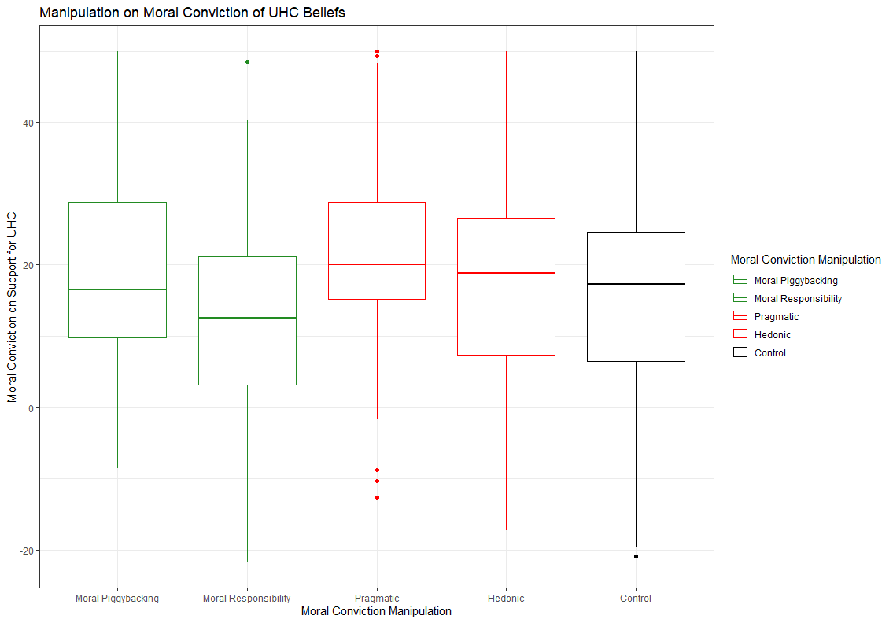
Results
Notes:
I am only going to show you the graph for universal health care, but the pattern is the same across all topics we examined.
First, I would like to orient you all to what the graph says, the Y- axis here shows amount of moral conviction for the topic, the X-axis shows what experimental condition the subject was in
The green shading shows the two conditions intended to increase moral conviction, the moral responsibility and moral piggybacking framings, the red shading shows the two conditions intended to decrease moral conviction, the pragmatic and hedonic framing, and the black shading is the control condition.
Each of these is a bar graph, where the mean response is the centermost line, the two next quartiles are the rest of the boxes, and the two ‘whiskers’ are the last two quartiles, with individual dots afterwards as relative ‘outliers’
There was no evidence for H1, as our moral piggybacking and moral responsibility groups combined did not have increased moral conviction as compared to the control group
Likewise, there was no support for H2, as our pragmatic and hedonic groups combined did not have decreased moral conviction as compared to the control group

Slide 28
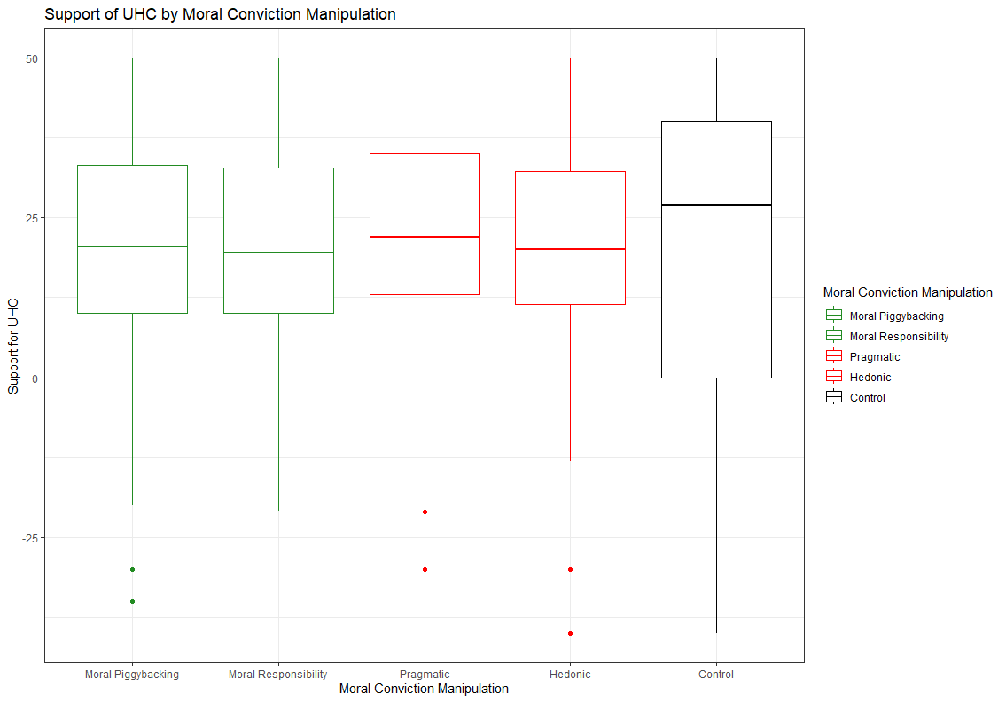
Results
Notes:
I am only going to show you the graph for universal health care, but the pattern is the same across all topics we examined.
First, I would like to orient you all to what the graph says, the Y- axis here shows amount of moral conviction for the topic, the X-axis shows what experimental condition the subject was in
The green shading shows the two conditions intended to increase moral conviction, the moral responsibility and moral piggybacking framings, the red shading shows the two conditions intended to decrease moral conviction, the pragmatic and hedonic framing, and the black shading is the control condition.
Each of these is a bar graph, where the mean response is the centermost line, the two next quartiles are the rest of the boxes, and the two ‘whiskers’ are the last two quartiles, with individual dots afterwards as relative ‘outliers’
There was no evidence for H1, as our moral piggybacking and moral responsibility groups combined did not have increased moral conviction as compared to the control group
Likewise, there was no support for H2, as our pragmatic and hedonic groups combined did not have decreased moral conviction as compared to the control group

Slide 29
Conclusions
Unable to increase moral conviction
Unable to decrease moral conviction
Potential unexplored interaction with social consensus
Notes:
While I was not able to find meaningful evidence of the impact of a moral conviction manipulation in a vacuum, prior literature indicates that in theory, there is a relationship between moral conviction and social consensus
It is still eminently possible that there is no detectable ‘main effect’ of our moral conviction manipulation, but that there could be an otherwise significant interaction with the effects of social consensus
Empirically testing this interaction was the impetus for Study 3

Slide 30
Study 3
Effect of the interaction between social consensus and moral conviction on polarized belief

Slide 31
Research Questions
How does moral conviction moderate the effects of social consensus?
Can we replicate the ‘inoculation’ from social consensus effect of having high moral conviction?
Notes:
The first research question we wanted to know was how moral conviction moderated the effects of social consensus can we inoculate from the effects of social consensus by increasing moral conviction, and can we increase the effects of social consensus by decreasing moral conviction

Slide 32
Study Design
Repeated measures design
2 Independent Variables:
Moral Conviction: Moral Responsibility or Pragmatic
Social Consensus: Low (-20%) or High (+20%)
Time: before and after Moral and Social manipulation
2 x 2 design
Three topics
Universal Health Care
Capital Punishment
AI in the Workplace
Notes:
This was a repeated measures design; I measured support for the polarized topics both before and after the two moral and social manipulation
Participants could be randomized into either a moral responsibility framing or pragmatic framing condition, and then could be randomized into either a low or high social consensus condition, resulting in 1 of 4 different combinations
Our participants were 491 psych 1000 students, averaging 18 years old, mostly female, mostly white
I will next show you examples of all the relevant experimental materials for the topic of UHC

Slide 33
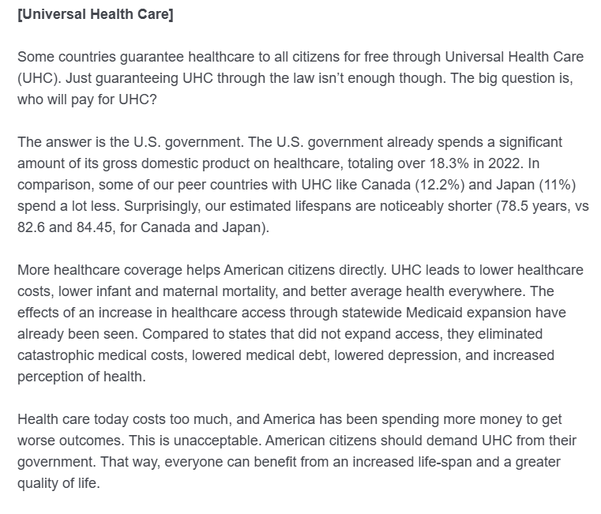
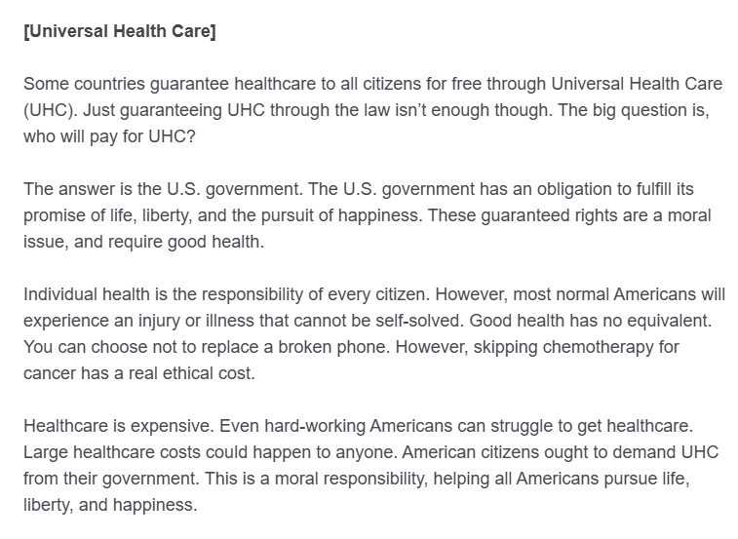
Moral Conviction Manipulation
Low Moral Conviction (Pragmatic)
High Moral Conviction (Moral Responsibility)
Notes:
First, our participants received the moral conviction manipulation,
Our moral conviction manipulation was very similar as in Study 2, I chose to only use one manipulation intended to decrease moral conviction, the pragmatic framing, and one to increase moral conviction, the moral responsibility framing.

Slide 34
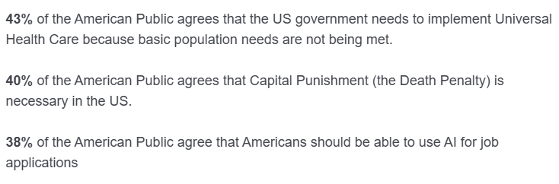
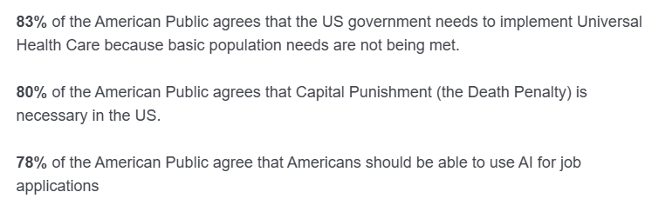
Social Consensus Manipulation
Low Social Consensus
High Social Consensus
Notes:
Next, the participants received our social consensus intervention,
The intervention was similar to that used for Study 1, where participants were given falsified consensus information,
20% below US survey data in the low social consensus condition,
and 20% above US survey data in the high social consensus condition

Slide 35
Outcomes
Notes:
Our outcome measures were jointly, the support for topic measure used in Study 1, and the 7 item aggregate moral conviction measure used in Study 2.

Slide 36
Hypothesis
H1: High social consensus will increase support for each topic
H2: Increased moral conviction will reduce the effect of social consensus, and decreased moral conviction will increase the effect of social consensus
Notes:
Our first hypothesis was to directly replicate the most promising result from Study 1
Our second hypothesis directly tests the more interesting question, whether or not increasing moral conviction can ‘inoculate’ someone from the effects of social consensus, and whether or not decreasing moral conviction can increase susceptibility to social consensus effects.

Slide 37
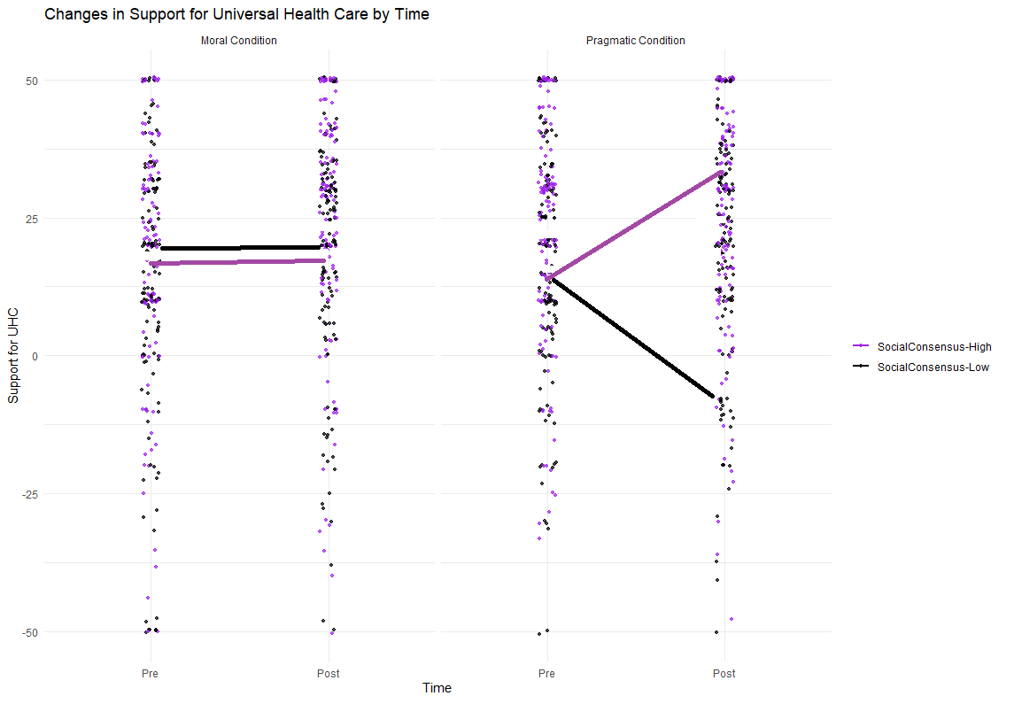
What would it look like if there WAS an interaction?
Notes:
Notably, here is an example graph that illustrates what it would look like if there was an intervention
If the hypothesized relationship was as expected
In the graphs to the left, the ‘moral condition’ increased moral conviction to the point where there is no effect from the social consensus condition, i.e., an ‘inoculation’ against it’s effects
Likewise, ain the graphs to the right, the pragmatic condition decreased moral conviction such that the social consensus intervention was even more effective, with high social consensus increasing support and low social consensus decreasing support.

Slide 38
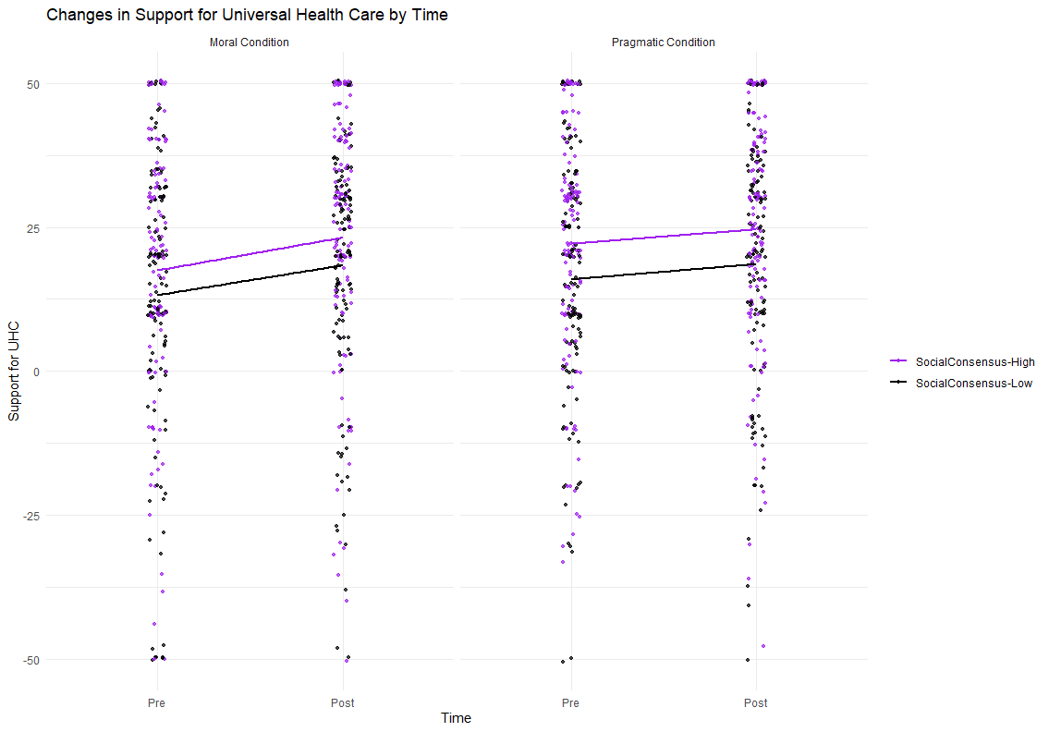
Results: NO interaction between social consensus and moral conviction
Notes:
On this second set of graphs, we’re now examining the interaction between social consensus and moral conviction
To orient you on the graphs, each set of graphs is similar to the graph you saw on the previous page.
The Y –axis shows support for UHC, the X-axis shows time, either before or after the dual interventions.
Color coding here is for which social consensus condition was received, green for high social consensus and orange for low social consensus.
The first set of graphs on the left show all individuals in the moral condition, and the second set of graphs on the right show individuals in the pragmatic condition.
While again, there was an overall increase of support from time 1 to time 2, we did not see an interaction between the effects of social consensus and moral conviction

Slide 39
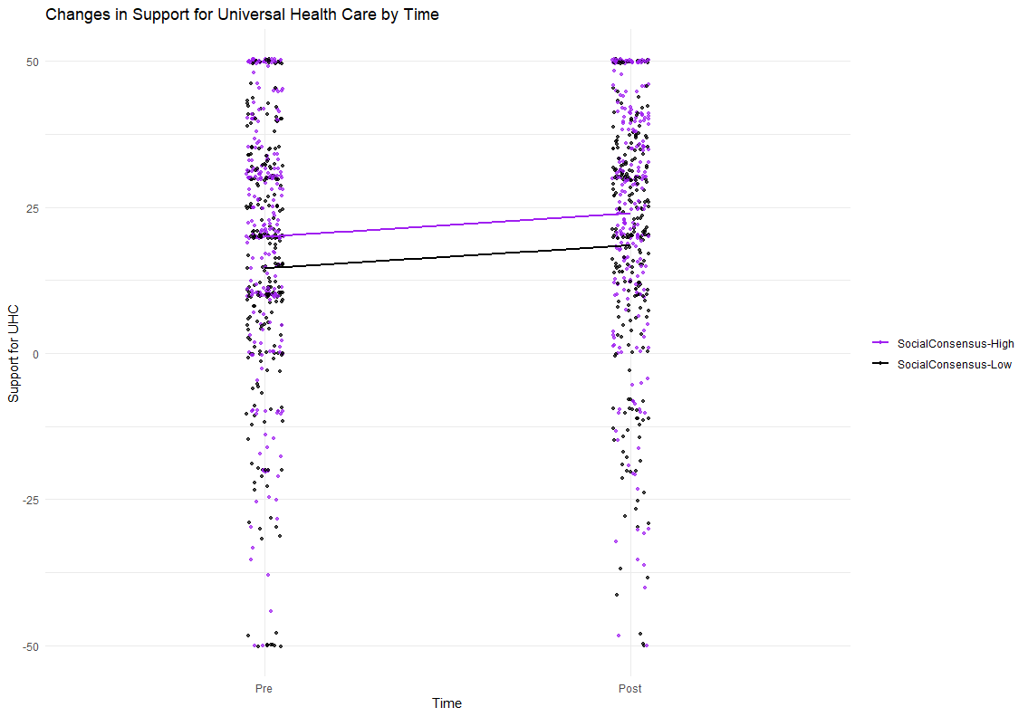
Results: NO main effect of Social Consensus on support for [topic]
Notes:
First, I would like to orient you all to what the graph says, also, I will only be showing the graphs for universal health care, but the pattern of results is similar for all of the topics
The Y- axis here shows support for the topic,
The X-axis shows time, either before or after our intervention
The color coding shows which intervention individuals received, red for the high social consensus, and blue for the low social consensus intervention, this graph is collapsed across the moral conviction interventions
The lines that go through the clouds of dots essentially summarize the relationship between consensus condition and time.
While there was an increase in support from time 1 to time 2, there was no difference between the high or low social consensus conditions

Slide 40
Conclusions
No main effect of social consensus on support
No significant interaction between social consensus and moral conviction
Significant pre-post increase in support for all topics
Both for high and low social consensus

Slide 41
Research Findings
By itself, social consensus intervention can increase support for some topics
Not successful at decreasing support compared to the baseline
Moral conviction very difficult to manipulate
Unable to find experimental evidence of an interaction between social consensus and moral conviction

Slide 42
Future Directions
Use ‘domain specific’ information
Qualitative research with individuals having polarized beliefs
What relevant traits/characteristics are seen as moral?
What relevant traits/characteristics are seen as non-moral?
Evidence of actual revealed preferences instead of self-report survey
‘Exercise’ – step counter/activity tracker
Climate change/Environmentalism – landfill waste/recycling volume
Alternative social consensus manipulations
Cheap and easy to do…
Not as effective as ‘Asch’, or other ‘in-person’ manipulations

Slide 43
Questions?
Thanks so much for coming!

